Slide 1
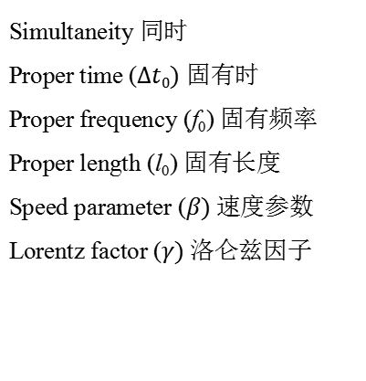
Key words
Relativity 相对性
Postulates 假设
Inertial reference frame 惯性参考系
Event 事件
Time Dilation 时间膨胀
Length Contraction 长度收缩
Spatial separation 空间间隔
Temporal separation 时间间隔
Lorentz Transformation 洛仑兹变换
Doppler Effect 多普勒效应
Simultaneity 同时
Proper time ($∆t0)$ 固有时
Proper frequency (f₀) 固有频率
Proper length (l₀) 固有长度
Speed parameter ($β)$速度参数
Lorentz factor ($γ)$洛仑兹因子

Slide 2
Two postulates
First postulate :
The laws of physics are the same for observers in all inertial reference frames (no acceleration ). No one frame is preferred over any other
Second postulate :
The speed of light in vacuum has the same value c in all directions and in all inertial reference frames (is independent of the motion of the source)

Slide 3
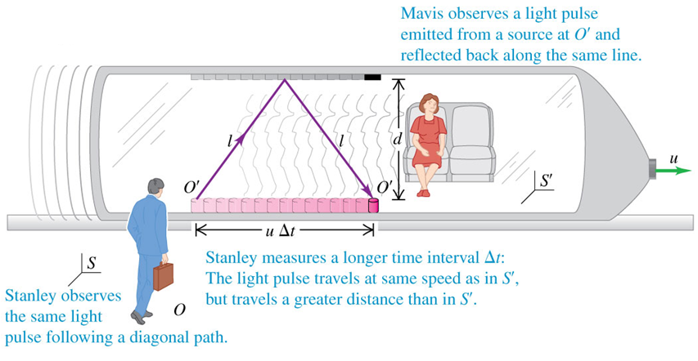
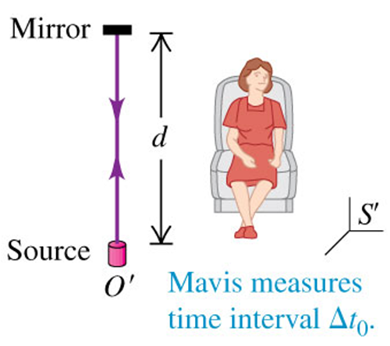

Relativity of time intervals
Combine the 2 equations :
Time dilation
Proper time：When two events occur at the same location in an inertial reference frame, the time interval between them, measured in that frame, is called the proper time. Measurements of the same time interval from any other inertial reference frame are always greater.

Slide 4


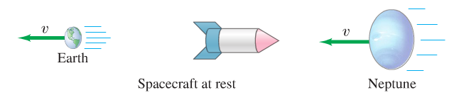


Length contraction
Measured on earth
If I am in the spacecraft, the earth is leaving me at a speed of v and Neptune is coming into me at v
proper time:
the length I experience :
Proper length：The length of an object measured in the rest frame of the object is its proper length or rest length. Measurements of the length from any reference frame that is in relative motion parallel to that length are always less than the proper length

Slide 5
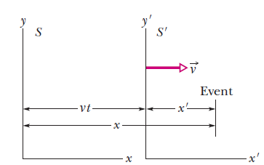

Galilean transformations VS Lorentz transformations
Galilean transformations:
Lorentz transformations :

Slide 6

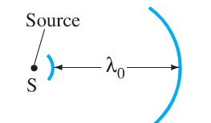


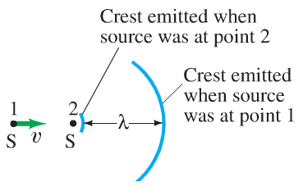





Doppler shift for light
Source Frame
period in the source stationary reference frame
Observe Frame
(source and observer moving toward each other)
(source and observer moving away from each other)

Slide 7
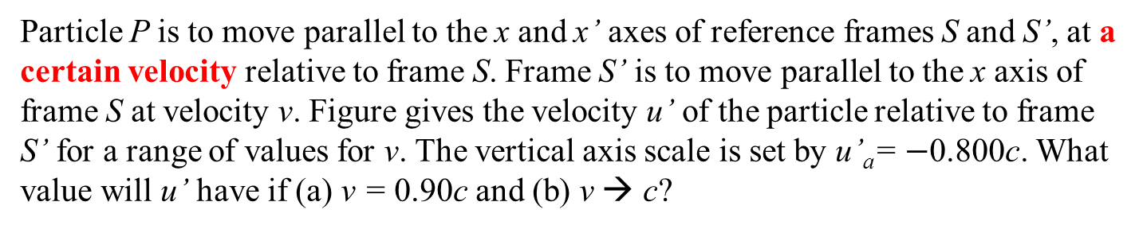
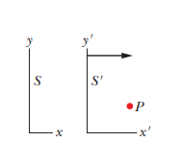
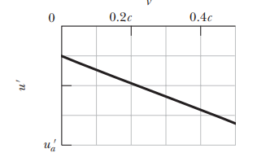
Problem 1

Slide 8
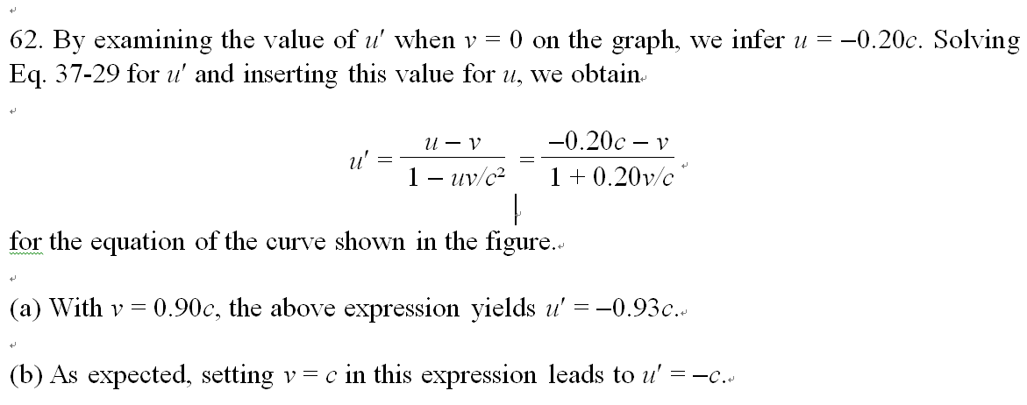
Answer 1

Slide 9
Problem 2
An armada (舰队 a large group of war ships) of spaceships that is 1.00 ly long (in its rest frame) moves with speed 0.800c relative to a ground station in frame S. A messenger travels from the rear of the armada to the front with a speed of 0.950c relative to S. How long does the trip take as measured
(a) in the armada’s rest frame
(b) in the messenger’s rest frame
(c) In frame S

Slide 10
Answer 2
(a) In the armada’s rest frame (called S_{a}), the velocity of the messenger is:
The length of the trip is proper length, and the time interval of the trip is
(b) In the messenger’s rest system (called S_{m}), the time interval of the trip is
proper time:

Slide 11
Answer 2
(b) In the messenger’s rest system (called S_{m}), the velocity of the armada is
The length of the armada as measured in S_{m} is
Thus, the length of the trip is:

Slide 12
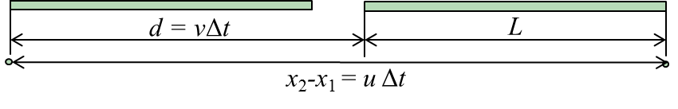
Answer 2
(c) in frame S
Event 1: messenger leaves the rear of the armada (x₁);
Event 2: messenger arrives at the front of the armada (x₂)
From the figure, we have:
The length of the armada in the S frame is:
Where , relates to the S frame and armada’s frame
So we can get the time interval in the frame S:

Slide 13
Answer 2
(c) in frame S
Event 1: messenger leaves the rear of the armada (x₁);
Event 2: messenger arrives at the front of the armada (x₂)
Alternatively, we also can get the time interval in S frame from the Lorentz transformation:
For the frame S and message’s frame:
For the frame S and armada’s frame:

